Slide 1
Image Captioning using Visual Attention
Final Project Group1
Contributors: Adel Hassen, Lydia Teinfalt, Alice Yang
Machine Learning 2 (George Washington University, Spring 2022)

Slide 2
Content
Introduction
Model
Attention Method
Implementation
Results
Conclusions

Slide 3
Introduction

Slide 4
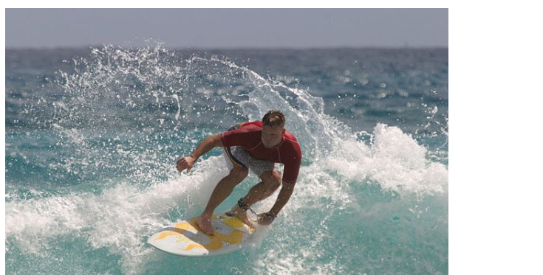
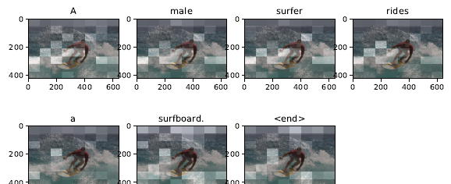
Image Caption Generation
Problem Statement
Automatically generating caption to pictures
Detecting objects within an image
Translating an image to text
Creating the caption in natural language
Why is it important?
How can Neural Network help in solving this problem?
Transfer Learning
CNN
RNN
Image Source; License: Public Domain

Slide 5
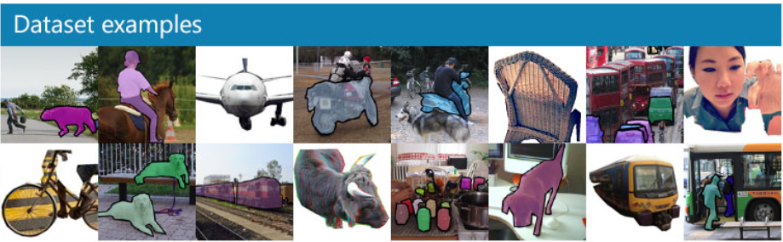
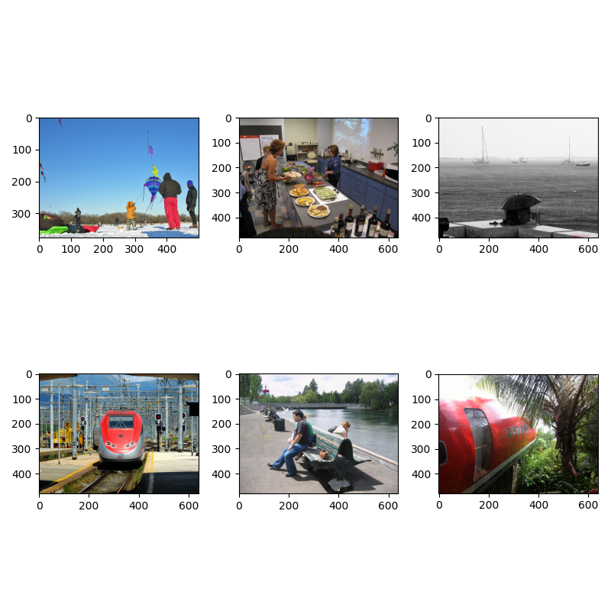
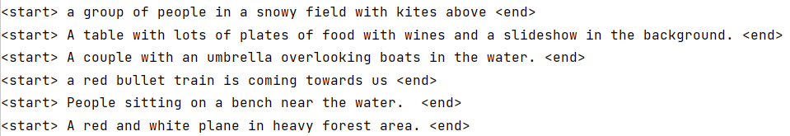
COCO 2014 Dataset
COCO: Common Objects in Context
Large scale dataset published by Microsoft. Dataset organized by year of published date
2014 Dataset
Original dataset has over 120,000 images for training, validation and testing
91 object categories
82 categories with 5,000 labeled images
Our project used subset of the COCO dataset. Each image has five captions
COCO dataset was used for training and testing
New Yorker cartoons for evaluation
Image Source: https://cocodataset.org/#home

Slide 6
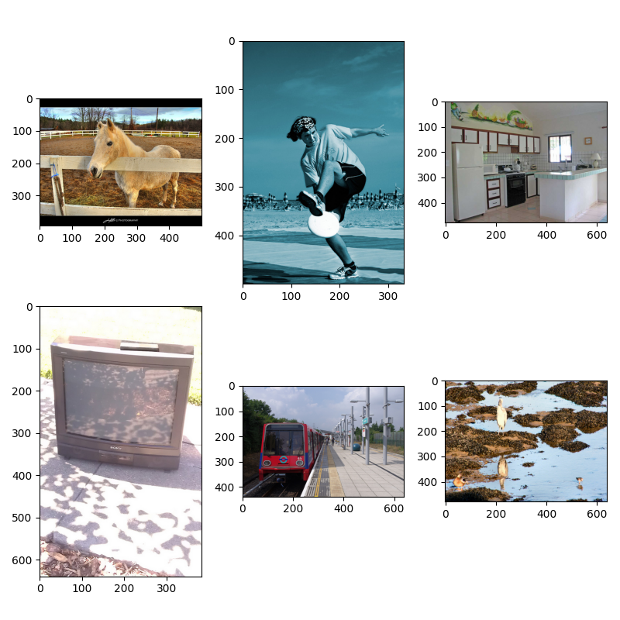
Sample Data and Caption from COCO 2014
<start> a tan horse standing next to a fence with a head over it <end>
<start> A man holding a frisbee while standing on a beach. <end>
<start> The small kitchen has a bar across from the stove. <end>
<start> Television sitting outside on the sidewalk on a sunny day. <end>
<start> A very pretty long red train by a platform. <end>
<start> a couple of birds standing by some water <end>

Slide 7
Model Architecture

Slide 8
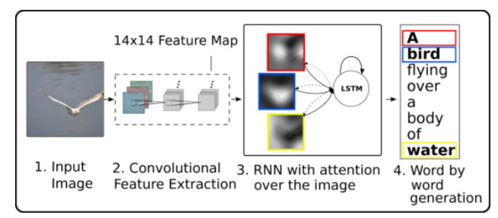
Model Architecture
Show, Attend and Tell: Neural Image Caption Generation with Visual Attention
Paper published in 2016 by Xu, Kelvin. Ba, Jimmy. Kiros, Ryan. Cho, Kyunghyum. Courville, Aaron.
Salakhutidnov, Ruslan. Zemel, Richard. Bengio, Yoshua.
Encoder-Decoder Model
Encoder: Convolutional Neural Network (CNN) extracts feature vectors from raw image
Decoder: RNN using Long Short-Term Memory Network (LSTM) architecture
Attention mechanism: The RNN output depends on the previously generated word
Google Translate API
Image Source: https://kelvinxu.github.io/projects/capgen.html
Notes:
Out model will has three main parts: a convolutional neural network (CNN) that extracts features from images, an attention mechanism that weights the image features, and an RNN that generates captions to describe the weighted image features. In the following sections, we will describe each in turn.

Slide 9
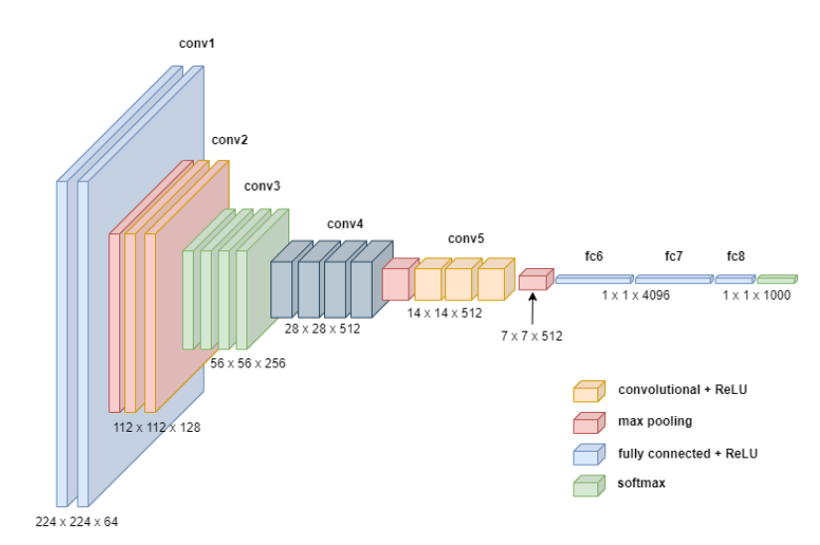
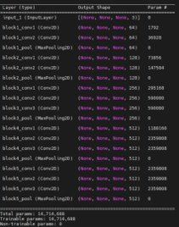
CNN – Transfer Learning
Input: raw image
Output: annotation vectors
VGG16 – idea proposed by Karen Simonyan and Andrew Zisserman in 2013
Extract features from lower convolution layer instead of fully connected layer
14 x 14 x 512
Acts an encoder in an encoder-decoder model
Image source: VGG-16 Architecture rendered using diagrams.net

Slide 10
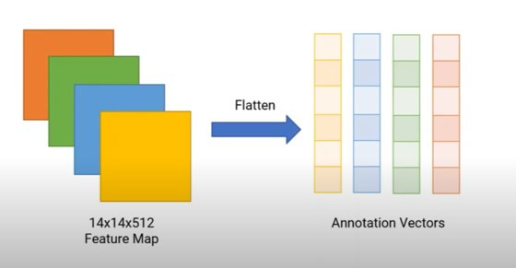
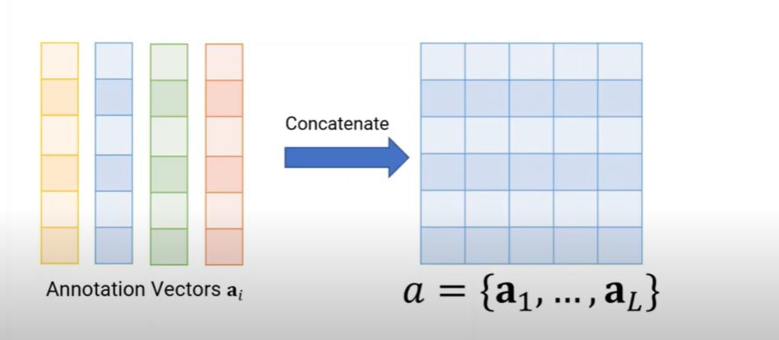
Annotation Vectors Encoded into Matrix
Image source: Show, Attend and Tell Explained
Matrix a is the output of our CNN encoder
Decoder will use matrix to identify sections of the image most important for predicting the next word

Slide 11
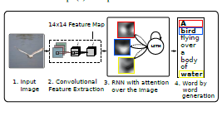
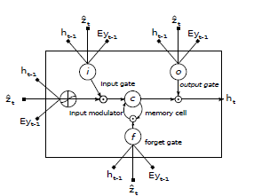
RNN Decoder
Eyt-1 : Previously generated word multiplied by embedding matrix​
Ht-1: Previous decoder hidden state​
zt: Context vector representing relevant part of the input image at time t
Image Source: Show, Attend and Tell Paper
Notes:
Out model will has three main parts: a convolutional neural network (CNN) that extracts features from images, an attention mechanism that weights the image features, and an RNN that generates captions to describe the weighted image features. In the following sections, we will describe each in turn.

Slide 12
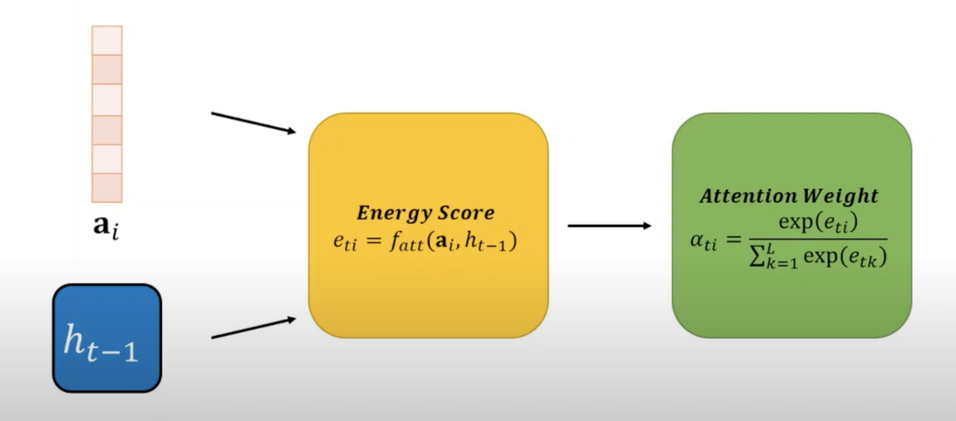
Energy and Attention
Probability that location i is the right place to focus to predict the next word
Image source: Show, Attend and Tell Explained

Slide 13
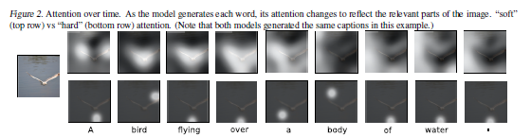
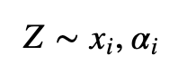
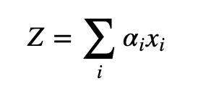
Hard vs. Soft Attention
Stochastic Hard Attention
Input xi with a sample rate αi into LSTM
Deterministic Soft Attention
Input the sum of xi*αi with weighted averages αi into LSTM
Image Source: Show, Attend and Tell Paper

Slide 14
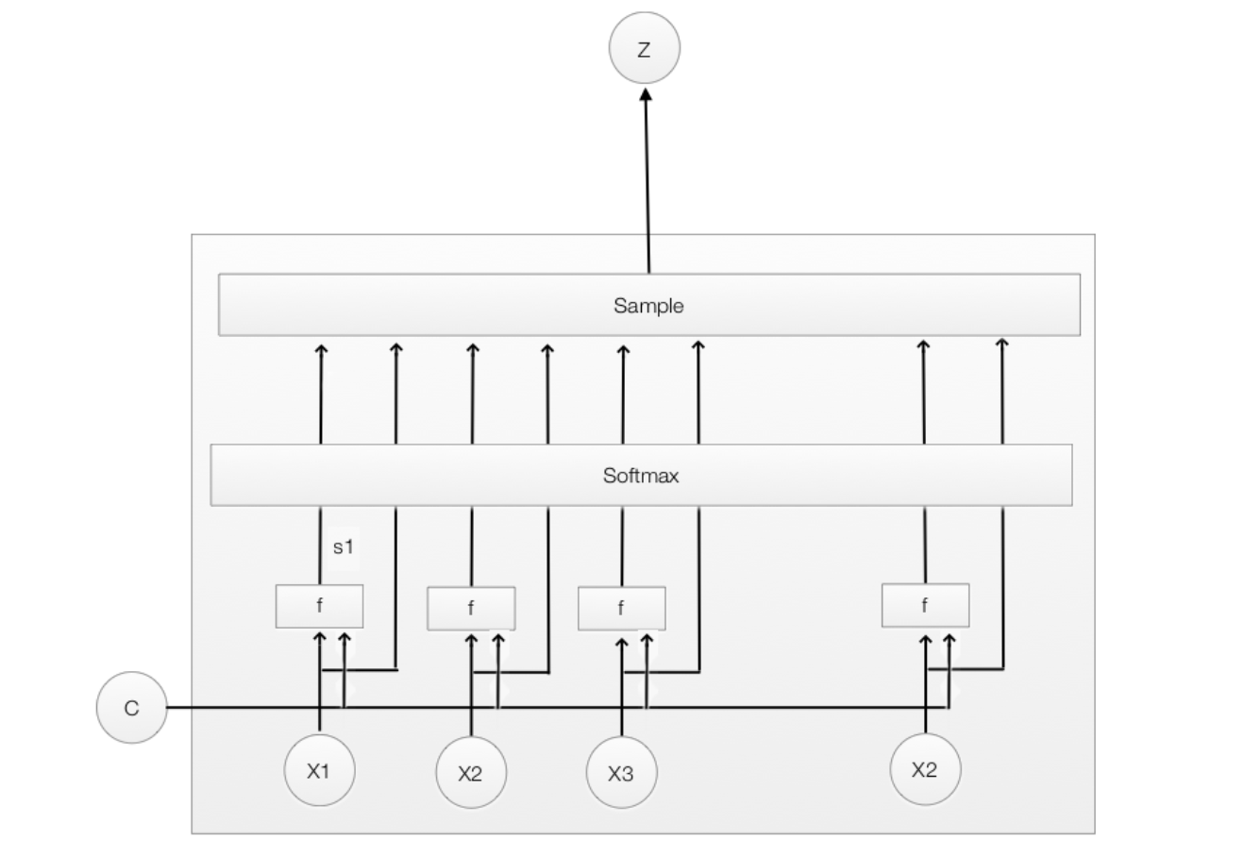
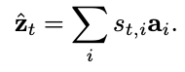
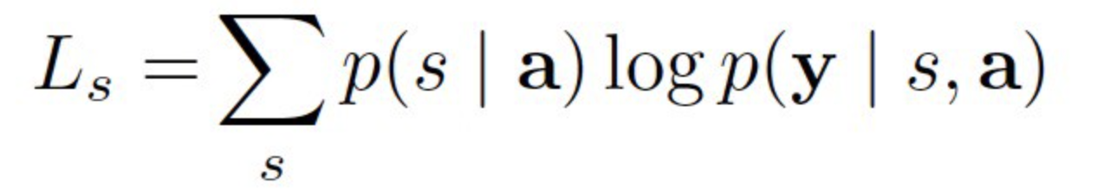
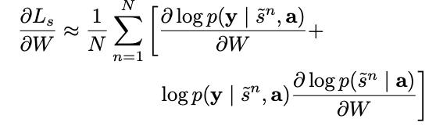
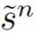
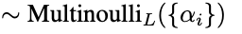
Stochastic Hard Attention
Contex Vector z:
Learning Algorithm:
Gradient of Ls:
where

Slide 15
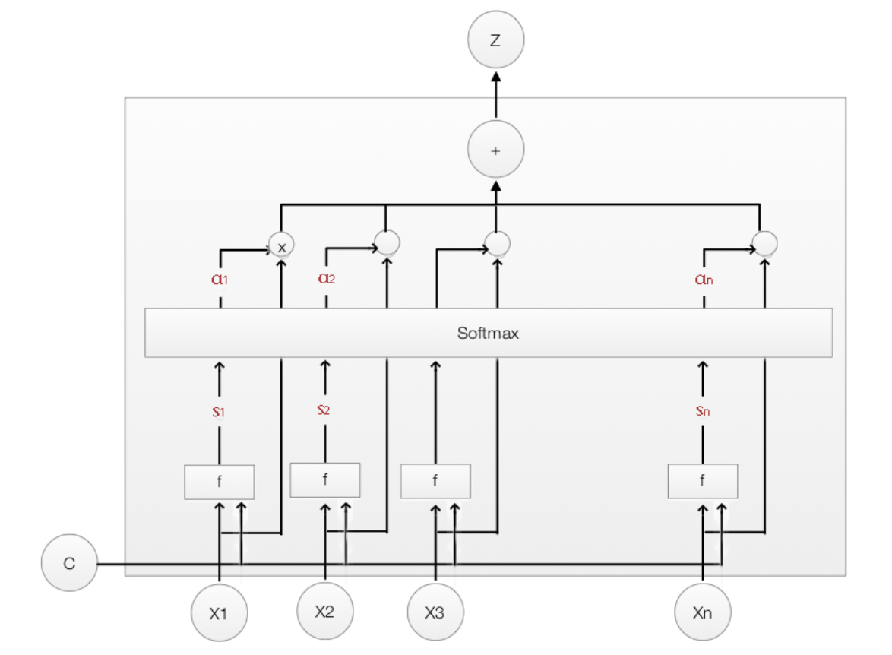
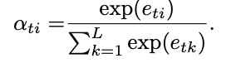
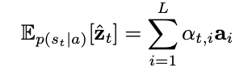
Stochastic Soft Attention
Score function si :
measures how much attention is applied to xi
Weight αi:
Where αi sum up to 1
Context Vector z:

Slide 16
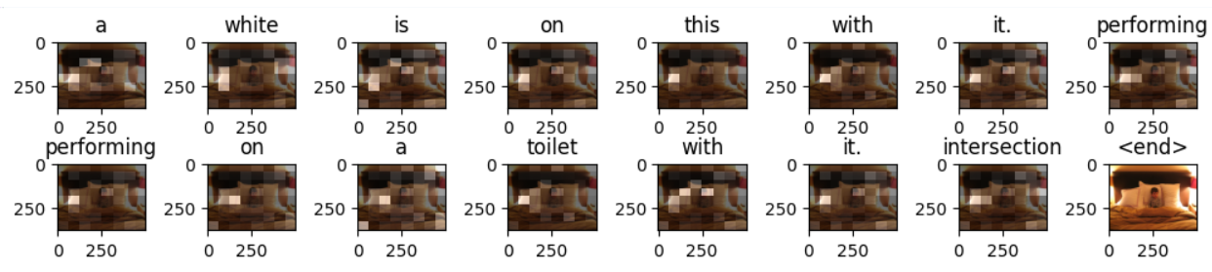
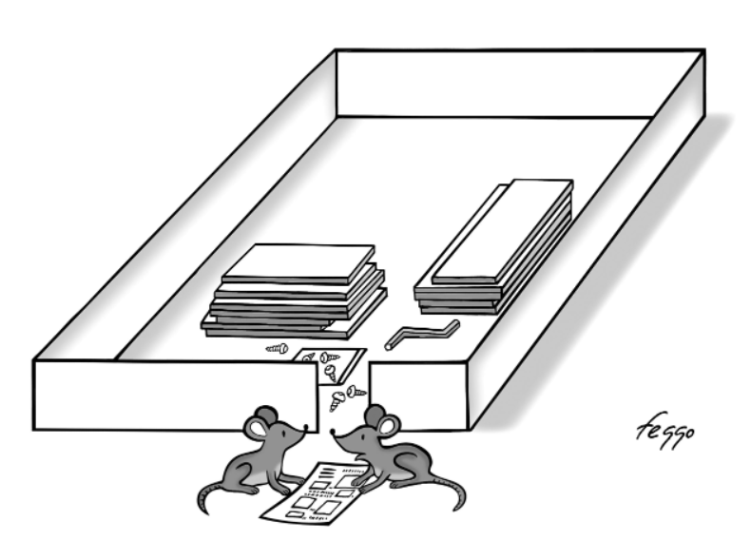
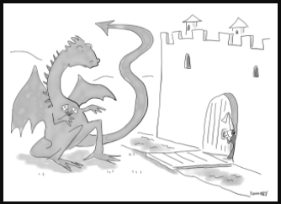
Training and Evaluation
Number of epochs = 50​,
COCO 2014 Dataset​
Training Images: 40,018
Training Captions: 200,090
Test Images: 10,003
Test Captions: 50,015
Evaluation using New Yorker cartoons
Translations by Google Translate API
Image Source: https://github.com/nextml/caption-contest-data/tree/gh-pages/cartoons
Generated Caption: A table [UNK] a table and a box placed on it. <end>
German Translation:
Ein Tisch [UNK] ein Tisch und eine darauf gestellte Kiste. <Ende>
Generated Caption: Many cows lounging at sheep goat <end>
German Translation:
Viele Kühe räkeln sich bei der Schafziege <Ende>

Slide 17
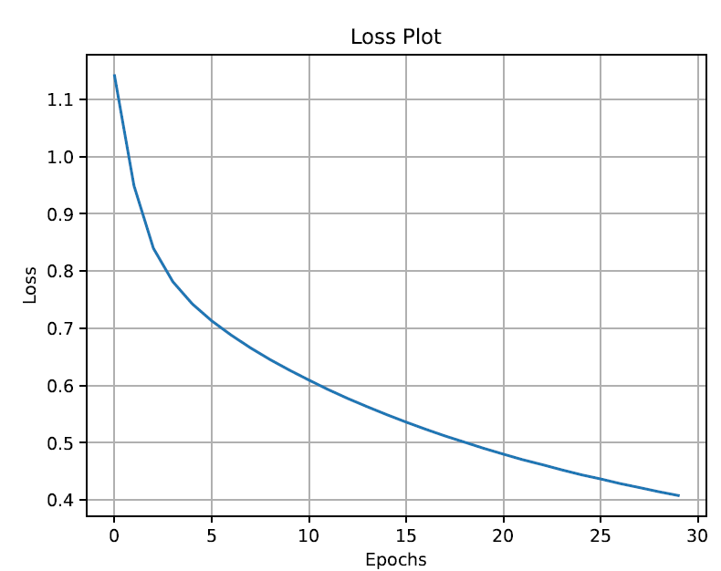
Adam Optimizer

Slide 18
Results

Slide 19
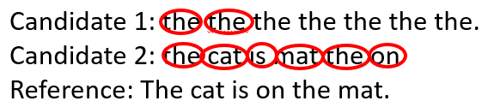
BLEU Score
BLEU: Bilingual Evaluation Understudy
Evaluate quality of machine-generated text against reference text
Compares n-grams of candidate with n-grams of reference and counts matches
Score between 0 and 1
Source: https://aclanthology.org/P02-1040.pdf
Image source: https://towardsdatascience.com/bleu-bilingual-evaluation-understudy-2b4eab9bcfd1

Slide 20
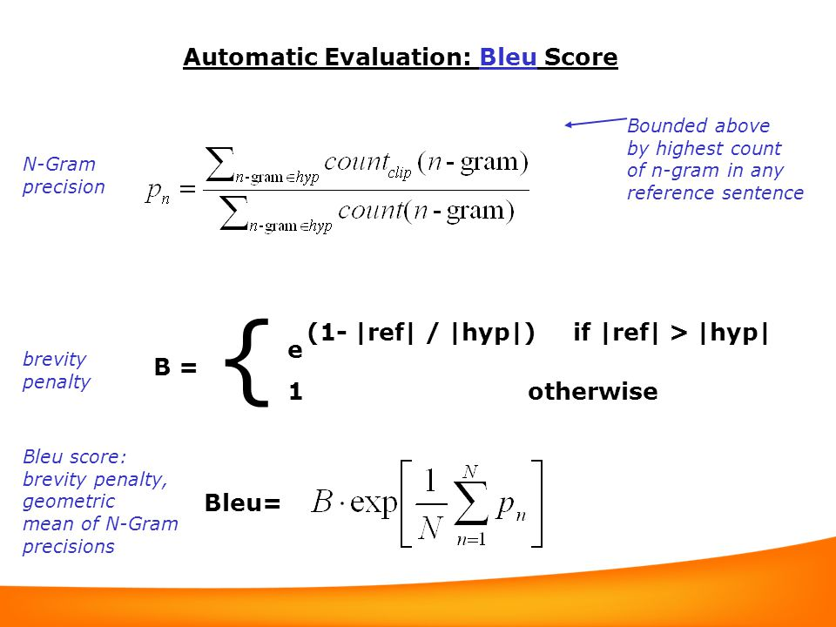
BLEU Formula
Modified n-gram precision: clip counts of n-grams to the number of occurrences in the reference
Source: http://kv-emptypages.blogspot.com/2017/04/the-problem-with-bleu-and-neural.html
Image source: http://kv-emptypages.blogspot.com/2017/04/the-problem-with-bleu-and-neural.html

Slide 21
 | BLEU-1 | BLEU-2 | BLEU-3 | BLEU-4
Our model | 46.4 | 23.9 | 12.3 | 6.3
Soft-attention | 70.7 | 49.2 | 34.4 | 24.3
Hard-attention | 71.8 | 50.4 | 35.7 | 25.0

Slide 22
Conclusions

Slide 23
Summary
We built a working model using visual attention, trained on COCO dataset, taking in a raw image and creating a caption
The visual attention mechanism resembles what humans do on an intuitive level
Tested our models against New Yorker cartoons with interesting captions
BLEU score for model performed 50% below the results in Show, Attend and Tell paper
The model is slow to train ~ over 2.5 minutes per epoch
Google API Translate works well but not suitable for scaling large volumes of captions

Slide 24
References
COCO - Common Objects in Context. (n.d.). COCODataset. Retrieved April 11, 2022, from https://cocodataset.org/
Hui, Jonathan. "Soft & Hard Attention", 15 Mar. 2017, https://jhui.github.io/2017/03/15/Soft-and-hard-attention/
Image captioning with visual attention | TensorFlow Core. (2022, January 26). TensorFlow. Retrieved April 15, 2022, from https://www.tensorflow.org/tutorials/text/image_captioning
Makarov, Artyom. “Image Captioning with Attention: Part 1.” Medium, Analytics Vidhya, 14 Dec. 2020, https://medium.com/analytics-vidhya/image-captioning-with-attention-part-1-e8a5f783f6d3
Section 508 (Federal Electronic and Information Technology). (n.d.). U.S. Access Board. Retrieved April 25, 2022, from https://www.access-board.gov/law/ra.html
Show, Attend And Tell - Paper Explained. (2021, May 3). YouTube Halfling Wizard. Retrieved April 16, 2022, from https://www.youtube.com/watch?v=y1S3Ri7myMg&t=6s
Sarkar, Subham. “Image Captioning Using Attention Mechanism.” Medium, The Startup, 15 June 2021, https://medium.com/swlh/image-captioning-using-attention-mechanism-f3d7fc96eb0e.
Xu, Ba, Kiros, K. J. R. (2016, April 19). Show, Attend and Tell: Neural Image Caption Generation with Visual Attention. Arxiv.Org. Retrieved April 4, 2022, from https://arxiv.org/pdf/1502.03044.pdf?msclkid=97863852c49311ecb15903abb2f078b2
Khandelwal, R. (2021, December 13). BLEU — Bilingual Evaluation Understudy - Towards Data Science. Medium. Retrieved April 26, 2022, from https://towardsdatascience.com/bleu-bilingual-evaluation-understudy-2b4eab9bcfd1
Brownlee, J. (2019, December 18). A Gentle Introduction to Calculating the BLEU Score for Text in Python. Machine Learning Mastery. Retrieved April 26, 2022, from https://machinelearningmastery.com/calculate-bleu-score-for-text-python/
Papineni, Roukos, Ward, Zhu (2022, July 1). BLEU: a Method for Automatic Evaluation of Machine Translation. Dl.acm.org. Retrieved April 26, 2022, from https://aclanthology.org/P02-1040.pdf
Vashee, Kirti. (2017, April 11). The Problem with BLEU and Neural Machine Translation. Blogger.Com. Retrieved April 26, 2022, from http://kv-emptypages.blogspot.com/2017/04/the-problem-with-bleu-and-neural.html

